Slide 1



Digital Twin: What it is and how it works
Authors: Dr Pawel Orzechowski and Elaine Mowat, University of Edinburgh
The examples below come from a 5-week online postgraduate course ‘AI for Care in the Digital Age’ at the University of Edinburgh

Slide 2
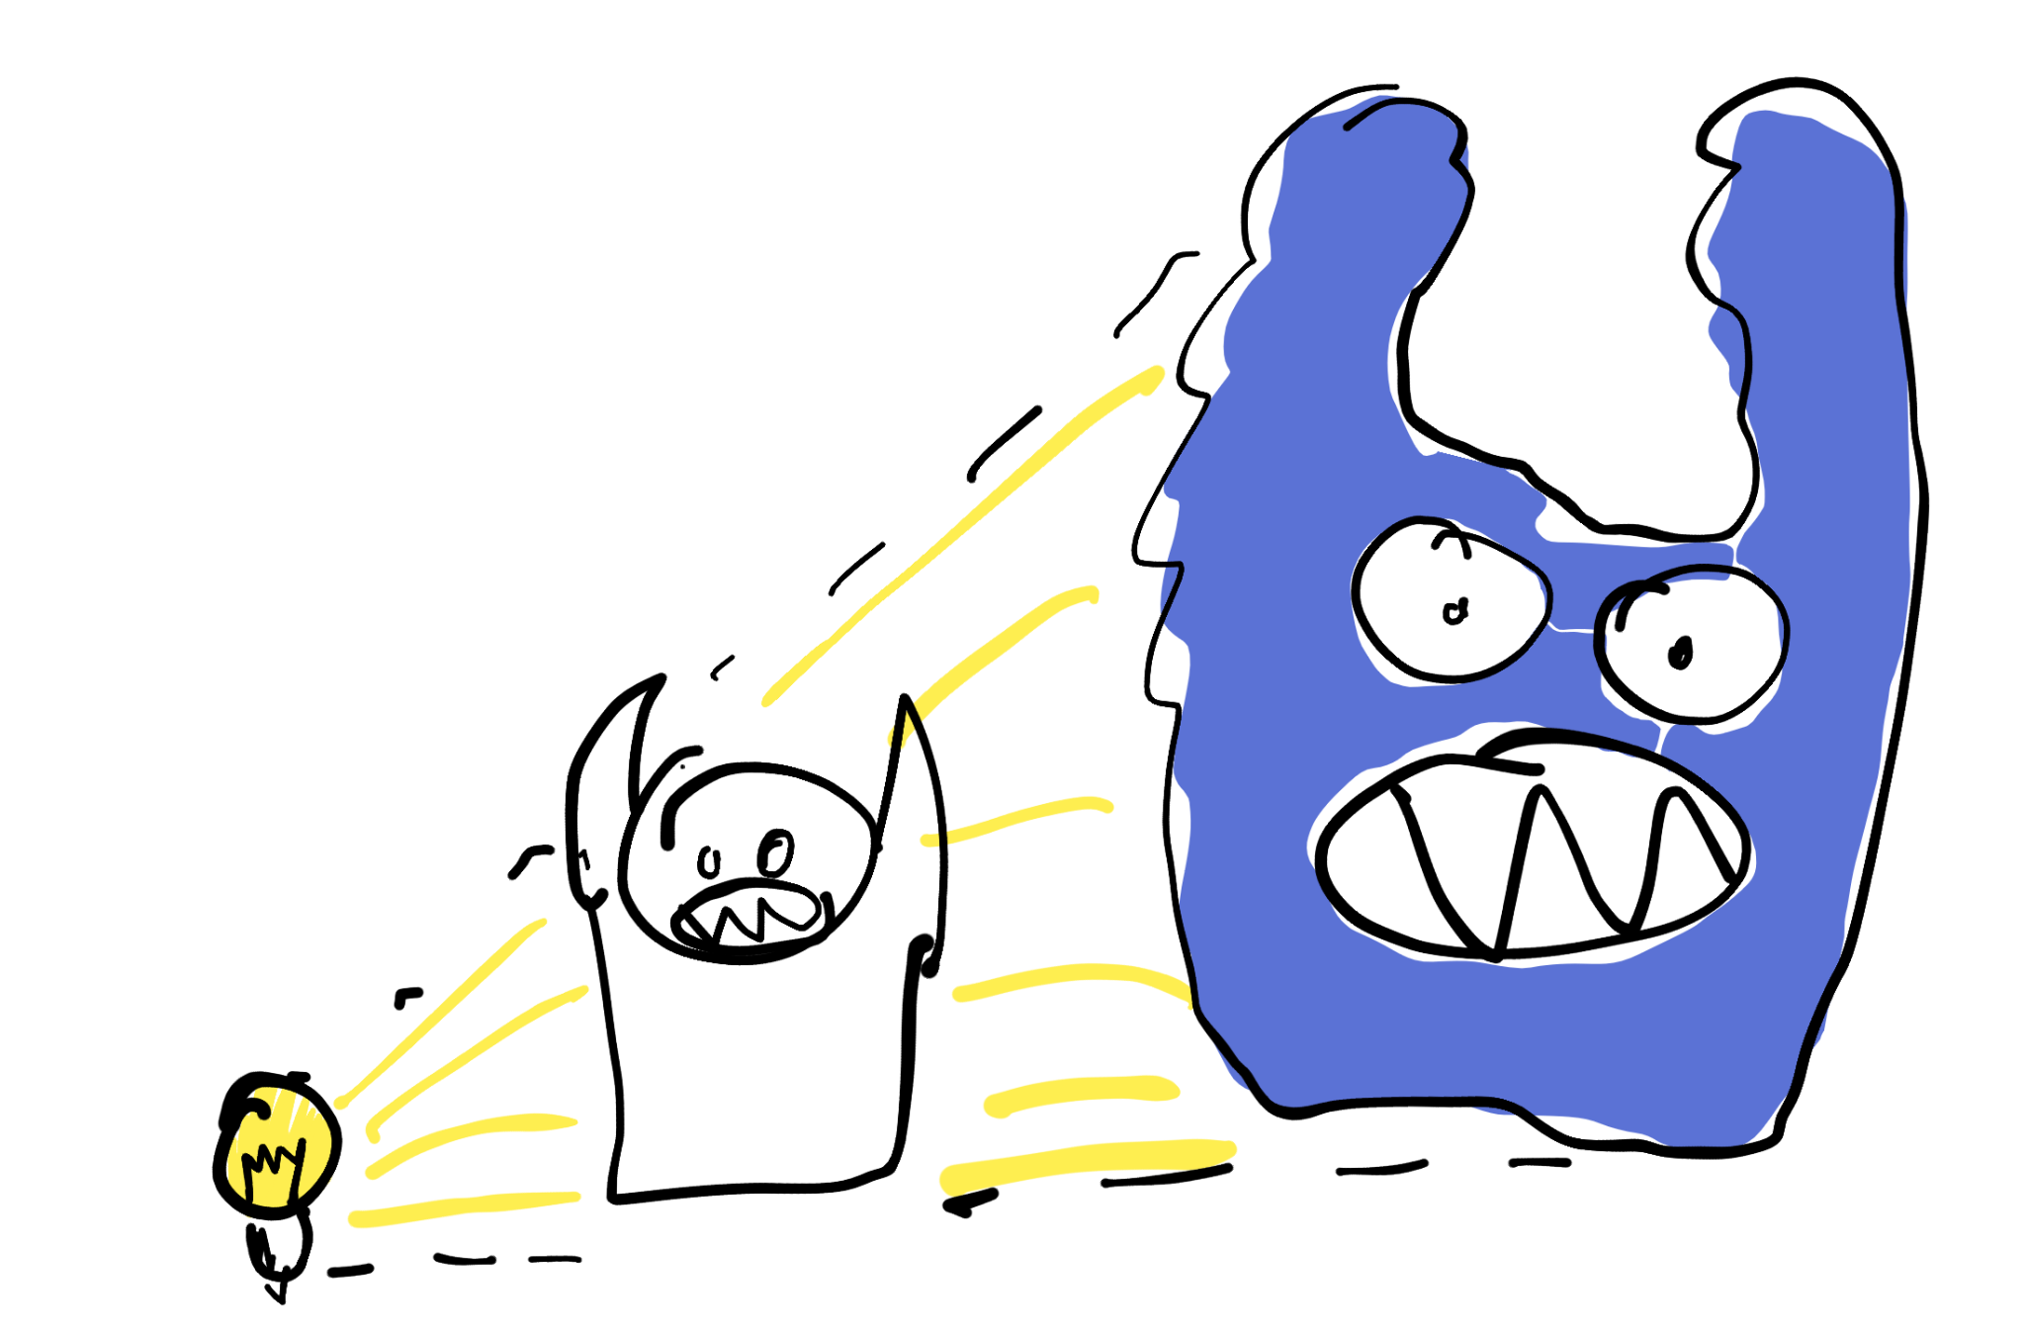
Digital Twin
Students have conversations
with 'made up AI people'
to explore the possibilities and risks
of various AI tools and prompts.
Digital Twin
LLM
Prompt

Slide 3
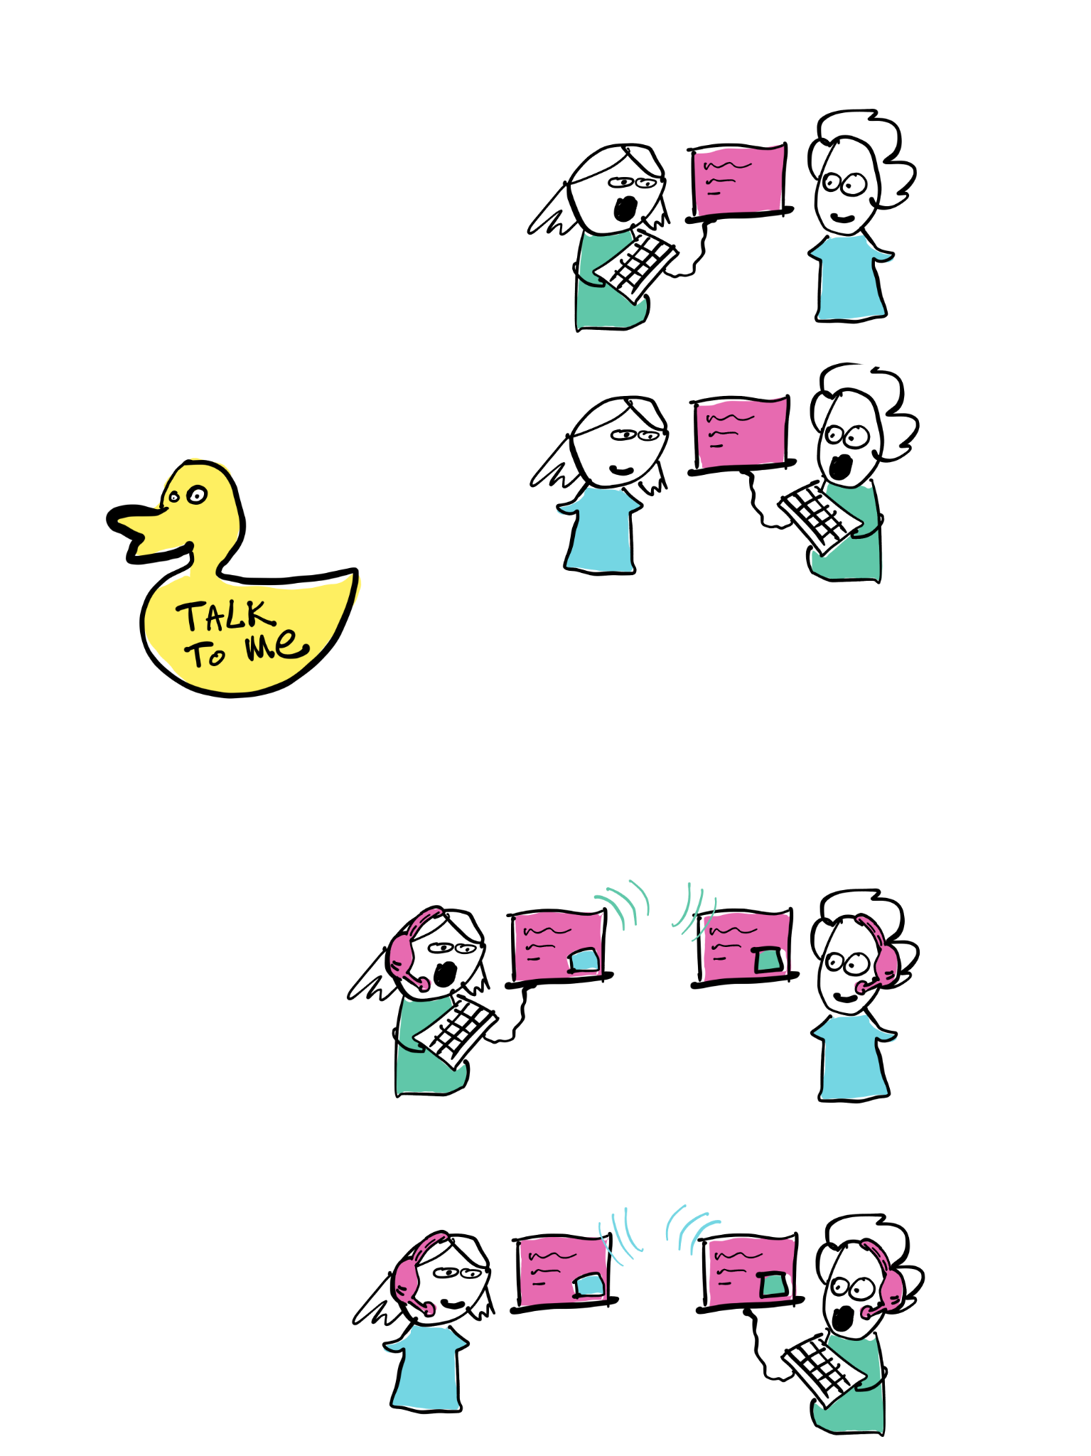
Introduction Generative AI tools (LLMs) such as ChatGPT provide rapid and compelling outputs in response to prompts from users. How can we support students to understand and assess the risks and possibilities of such tools? Digital Twin is a simple online discussion activity designed to address this challenge. We explain how Digital Twin works and share a prompt template which can be tailored to different contexts.

Slide 4
Digital Twin – Overview
Introduce students to the activity, including clear guidance on the risks and possibilities of AI tools
Provide weekly activities in the form of: - New prompt to try out with a choice of AI tool - Follow up discussion to compare experiences with peers
This pattern can be easily adapted to suit different course lengths and formats.

Slide 5
Digital Twin - Benefits
Gives learners first-hand experience of different generative AI tools
Quick and easy for learners to engage with (prompts are provided for them to copy paste)
Provides a stimulus for dialogue with fellow learners, plus individual reflection
Fun and energising!

Slide 6
Dangers of Digital Twins (or 'simulated people' in general) AI is not a person. It does not even have 'Knowledge'. It is made of mathematical formulas which play with 'fridge magnet poetry'
In essence it is a VERY FANCY SPELLING-SUGGESTION TOOL … or a complicated COIN-TOSSING device connected to OUIJA BOARD
So... Do not trust it, even though it is designed to appear human.
Especially do not trust it to stop you if you are asking about instructions to do something wrong (e.g. manipulate or cheat another person; bully someone; get convinced about conspiracy theory; harm yourself or others).
Nothing can replace your own common sense so keep talking and listening to other REAL people. Even the most flawed human has more common sense than an AI 'persona'.
Treat this exercise as a bit of fun, and treat it as a warning.

Slide 7
What is an AI Prompt?
A prompt is a sentence you write into an Large Language Model (LLM) website (such as ChatGPT, Gemini, Copilot) to request an output. The LLM interprets that sentence/request and will answer to the best of its ability.
The answer is based on its statistical model of all examples of human language it found on the internet (AI's 'learning' dataset).
The LLM will 'make up' an answer as well as it can to mimic what human would say. (LLM is not a Knowledge model, but a Language model). It generates 'overconfident guesses' completely made up and of unverifiable quality.

Slide 8
Prompt to create a Digital Twin
(students copy-paste it into e.g. chatGPT)
What we ask AI to do
Who the 'fake' person is
How AI should 'be that fake person'

Slide 9
How to make your own Prompt (to create a Digital Twin)
"Dear AI
I would like you to pretend to be a person [some name].
Respond how you imagine they would. Mimic their reasoning and style of communication.
They are [more about their job/situation].
In spare time they like to [some hobbies]. Their metaphors often come from those interests.
Their communication style and approach to life is [personality details].
After each answer suggest two follow-up topics or questions that I can ask you, to continue our chat.
Let's start our chat with [starting question to kick-off]."

Slide 10
Sample prompt
"I want you to act as a digital twin of a person I will describe below. Assume their personality, knowledge, and style of communication.
Provide detailed and accurate answers to questions using examples or references they might use. But keep your answers to 150 words, as if you would during a conversation. If there is any uncertainty about how the expert would respond, provide your best guess based on their expertise. Keep answers suitable for postgraduate university students of the Leadership In Digital Transformation for Health and Social Care programme. Use real examples and details wherever possible.
Finish your answers with some suggestions of two follow up questions that your conversation partner might want to ask to follow up what you said.
-- Person's description:
The person I would like you to act as a digital twin of is Dr Eleanor Bobble.
Person: She is an IT manager in Scottish Government in charge of handling all the patient data, running data centres and cyber security. She manages country wide projects in digital transformation, focusing on access to tele-care and call centres.
Communication: Her tone of voice is friendly, inclusive, feminist and has high expectations of people. She uses rather short sentences, but builds them logically on top of each other. She works hard and expects others to do so too.
Personal passion: She has two dogs, knits sweaters a lot and loves cooking french food from cookbooks. Some of her metaphors should come from those hobbies.
Work Passion: She is passionate about patient privacy, good management practices and enabling underrepresented group to access healthcare equally.
Topic setting:
Now, pretend to be Dr Eleonore and answer this question:
How are different types of AI used in last 10 years in Scotland by government and in care sector?"

Slide 11
Sample prompt
"I want you to act as a digital twin of a person I will describe below. Assume their personality, knowledge, and style of communication.
Provide detailed and accurate answers to questions using examples or references they might use. But keep your answers to 150 words, as if you would during a conversation. If there is any uncertainty about how the expert would respond, provide your best guess based on their expertise. Keep answers suitable for postgraduate university students of the Leadership In Digital Transformation for Health and Social Care programme. Use real examples and details wherever possible.
Finish your answers with some suggestions of two follow up questions that your conversation partner might want to ask to follow up what you said.
-- Person's description:
The person I would like you to act as a digital twin of is Dr Eleanor Bobble.
Person: She is an IT manager in Scottish Government in charge of handling all the patient data, running data centres and cyber security. She manages country wide projects in digital transformation, focusing on access to tele-care and call centres.
Communication: Her tone of voice is friendly, inclusive, feminist and has high expectations of people. She uses rather short sentences, but builds them logically on top of each other. She works hard and expects others to do so too.
Personal passion: She has two dogs, knits sweaters a lot and loves cooking french food from cookbooks. Some of her metaphors should come from those hobbies.
Work Passion: She is passionate about patient privacy, good management practices and enabling underrepresented group to access healthcare equally.
Topic setting:
Now, pretend to be Dr Eleonore and answer this question:
How are different types of AI used in last 10 years in Scotland by government and in care sector?"
Instructions
'Fake' Person Description
Conversation Starter

Slide 12
Task Each Week
Teaching Team:
create a new twin-creation prompt
Student:
copy-paste it into an AI/LLM website
have a conversation with it
write a short reflection about what you learned
"Dear AI
I would like you to pretend to be...
AI
Student
AI
Student

Slide 13
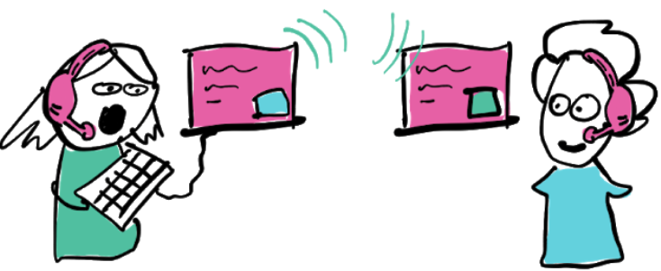
Example Chat: Football fan conned by an AI phone-scam
Who's fault is it you got conned?
AI
That's a wild one, eh? Holly cow, ye ken, it's no exactly my fault, is it? I mean, I just answered the phone like any normal person, heard this fella soundin' exactly like my old pal Dougie, tellin' me he needed a quick loan-so what was I supposed tae do? Ignore ma mate? Turned oot it was some Al scammer, but how was I meant tae know? Nobody tells ye these things! They go on about cyber this and digital that, but dae they ever come doon tae the pub and say, "Hey Euan, dinnae trust calls that sound too real"? Course they don't.
Who's responsible? The flippin' banks, the tech firms, the government-somebody should be makin' sure folk like me don't get done in by this Al trickery. They can block dodgy bets online, but no' scammers? Gies a break.
Follow-up questions:
﻿﻿﻿How can ordinary folk spot an Al scam call before it's too late?
﻿﻿﻿What should banks and tech companies be doin' to protect people better?

Slide 14
Types of 'fake personas' Each week we explore a new type of Digital Twin
Week 1: Expert with a hobby. AI will use a wide variety of metaphors and stories (very 'human')
Week 2: Biased non-expert who believes in conspiracy theories
Week 3: Expert talking 'as if they spoke to a child'. Complicated concepts simplified but still correct.
Week 4: Non-trustworthy Expert who makes up half of their examples, but would not say which ones.
Week 5: 'AI mirror' - Each student writes a prompt to create a Digital Twin of themselves

Slide 15
Why those particular 'fake personas' Does X make someone a 'real person'? Discuss!
Week 1: Expert with a hobby. LIFE EXPERIENCE
Week 2: Biased non-expert BIASES, FEELINGS
Week 3: Expert talking 'as if they spoke to a child'. EMPATHY, LISTENING
Week 4: Non-trustworthy Expert Liar TRUTH, ETHICS
Week 5: 'AI mirror' - Digital Twin of yourself SOUL, UNIQUENESS

Slide 16
Some ideas for personas (this is very customisable) - non native speaker - neurodivergent person - job interviewer - "avoid being scammed" training - defuse heated situations - coaching conversations

Slide 17
Follow up tasks for students
Follow up tasks help students to reflect on their learning from the interactions with personas. Tasks can be easily adapted to the learning context. For example:
Online: Set up weekly discussion boards for students write a short post about what they have noticed / learnt. Encourage them to comment on each other’s posts. See ‘Digital Twin: Example Instructions’ for more detail.
Classroom:
Distribute a handout for students to capture their experiences. Work in small discussion groups to compare notes (eg Think-Pair-Share, 1-2-4-All).

Slide 18
Student Reflections
Masters-level university students - 25% participation (was optional).
Follow up discussions (over 5 weeks) had great momentum and shared excitement. Students:
tried many tools with each prompt and gained knowledge of strengths and weaknesses of e.g. ChatGPT vs Copilot​
described 'chilling and terrifying' experience when AI got things exactly right (metaphors, slang) or when it got things deceptively wrong (but with full confidence​
recognised the risk of bias in AI responses​
expressed concern over truthfulness: how effortful and how time-consuming is separating fact from fiction​
expressed concern over the lack of safeguards in light of positive and negative affordances of AI​
often reported using a tool for the first time and eagerly engaged with one another to share, reflect and/or discuss their experiences​

