Slide 1


Open for Good
10 years of open course development at The University of Edinburgh

Slide 2
Welcome!
The story of MOOCs at UoE - Stuart Nicol
The MOOC development workflow – Fiona Buckland
Developing open media - Geoff Fortescue
Creative reuse of open media – Lorna M. Campbell
Promoting open learning opportunities– Lauren Johnston-Smith
Looking to the future – Stuart Nicol
Questions?

Slide 3

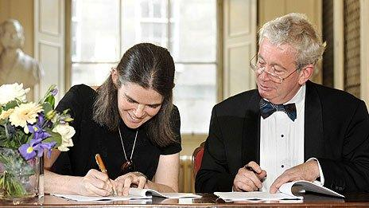
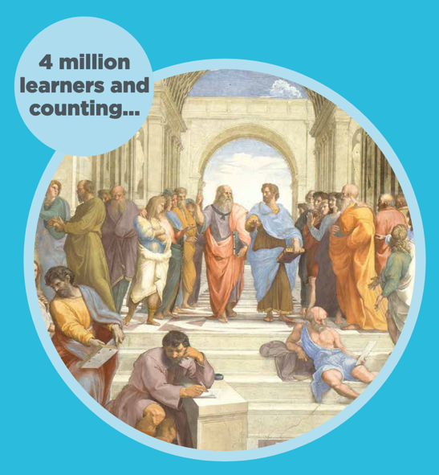
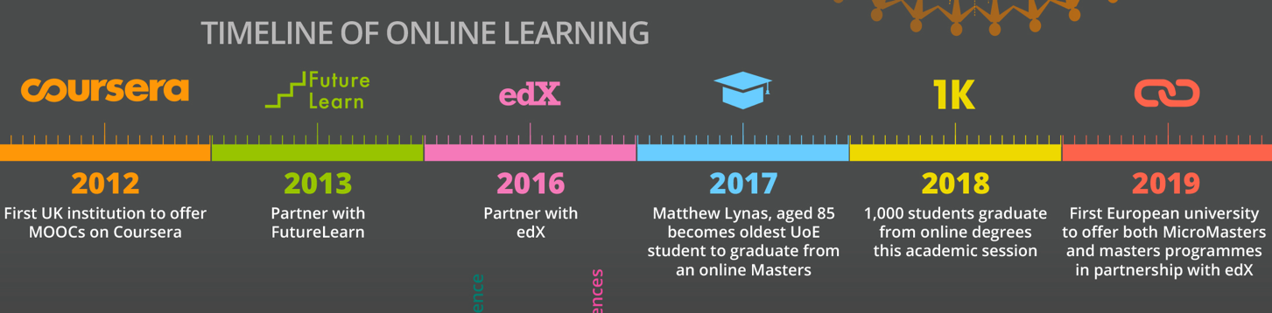
Edinburgh MOOCs: a story

Slide 4
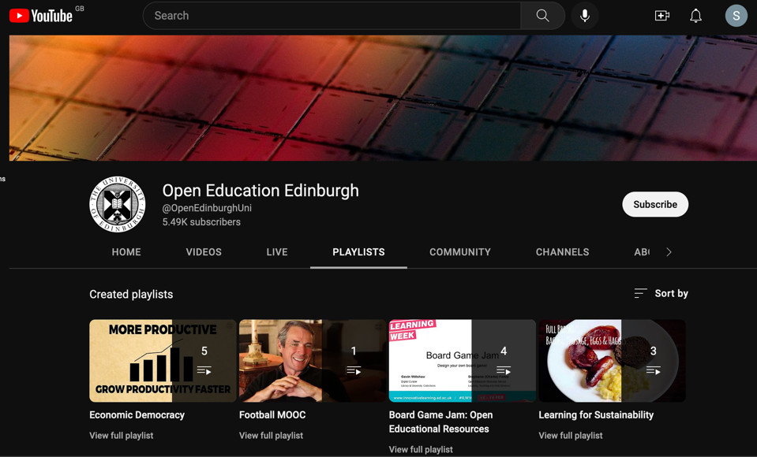
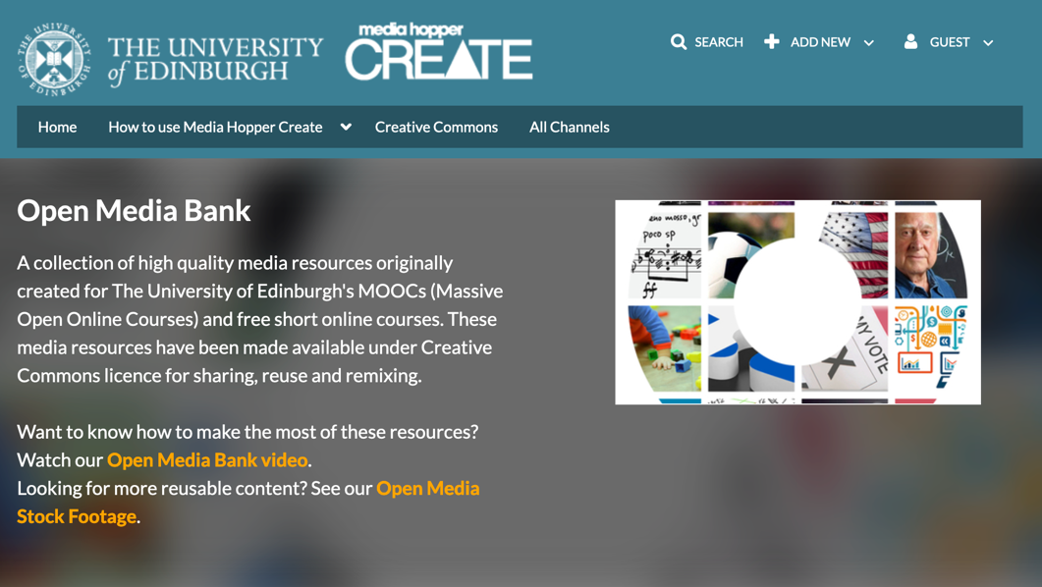
MOOCs & OERs
Notes:
It has taken a lot of trial and error and adaption to workflows to get us where we are now. Our earliest MOOCS were heavily based around video content for example courses such as X?
In the beginning attempts were made to host video content on YouTube, however this did not work as planned...

Slide 5
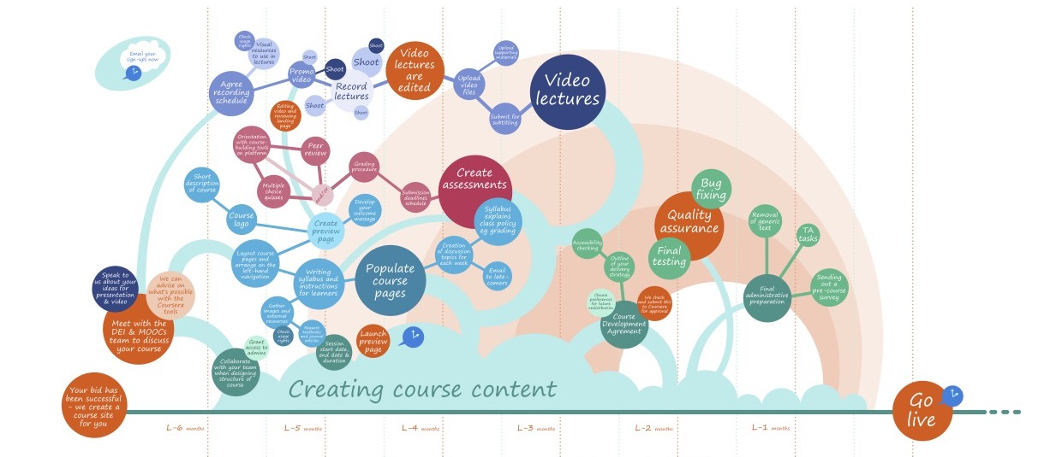
How we ‘grew’ Edinburgh MOOCs
Notes:
It has taken a lot of trial and error and adaption to workflows to get us where we are now. Our earliest MOOCS were heavily based around video content for example courses such as X?
In the beginning attempts were made to host video content on YouTube, however this did not work as planned...

Slide 6
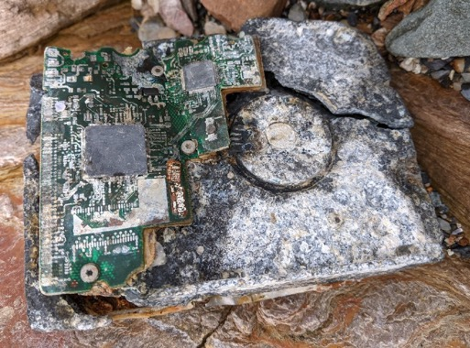

Fixing technical & copyright debt
"Technical debt is the implied cost of future reworking required when choosing an easy but limited solution instead of a better approach that could take more time. If technical debt is not repaid, it can accumulate 'interest', making it harder to implement changes." (Wikipedia).
Notes:
It has taken a lot of trial and error and adaption to workflows to get us where we are now. Our earliest MOOCS were heavily based around video content for example courses such as X?
In the beginning attempts were made to host video content on YouTube, however this did not work as planned...

Slide 7
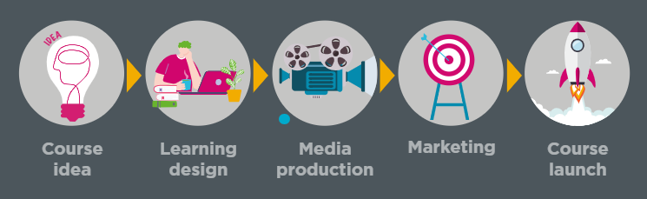
Adapting working practices to embed open content
Online Course Production team collectively work with course teams to manage the workflow and champion the use of OERs.
Notes:
Our Open Educational Resources Policy underpins our approach to online course design and development and this has been finessed over our years of working on massive open online courses. For those not familiar with OERs we can act as an educator for course teams and work with them to understand the benefits of using and creating OERs.
From initial course idea discussions, we advise course teams of the OER policy and our institutional commitment to open education. From there the instructional design team ensure we have a clear course development process in line with ABC learning design methods to incorporate active learning opportunities. By working collaboratively with the course team during the production of a course we can guide and support them to source a variety of open education resources for their course. The aim is to source, create and publish all course materials under open licence. We are fortunate to have the OER service who are on hand to review copyrighted materials and help us find alterative open resources where possible. Later in this presentation you will hear from our Media and marketing teams to show how OERS are woven into our multidisciplinary approach to online course creation. A commitment to sharing our high quality resources does not end when a course is launched. We have adapted out workflow to ensure that all media created is added to our Open Media Bank once a course launches where we can promote it to encourage the reuse and repurposing of the assets we have created.

Slide 8
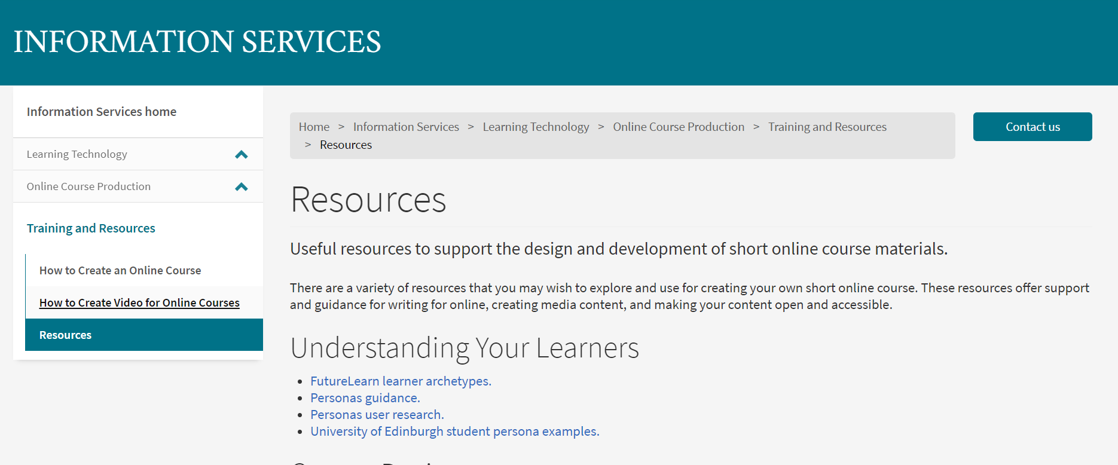
Sharing our knowledge
We offer free, open licensed, downloadable resources to support you in creating your own online materials.
Student persona examples
Content Writing Template Pack
OER Channels
Top 15 Accessibility Tips
Notes:
Along side the open media bank, we have collated several ways of sharing our OERS and are happy to share the resources we have developed and collated over the last 10 years.
We have a substantial list of resources on our website which includes materials such as: Student persona examples - A resource for helping to identify a target audience for an online course.
Content Writing Template – which is aligned with the ABC Learning Design method. OER Channels - A guide including links to websites for finding open licensed content so we can guide our teams to find their own OERs.
Top 15 Accessibility Tips - quick tips improve the accessibility of your materials.

Slide 9
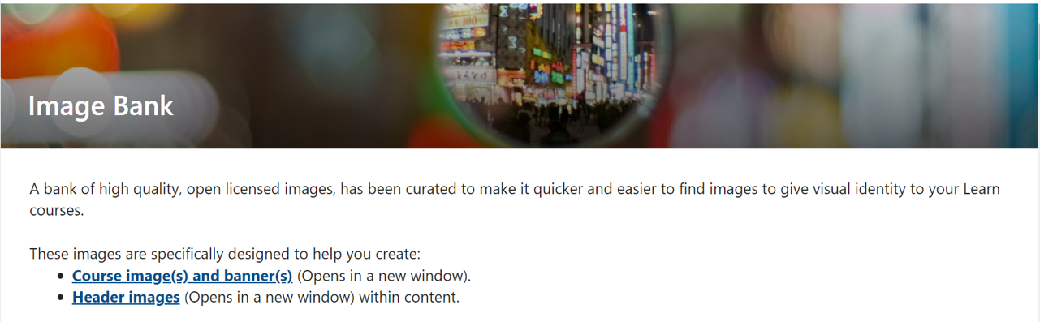
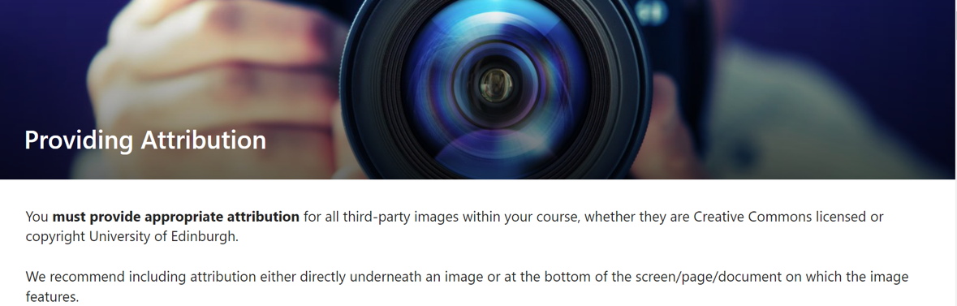
Image Bank
Notes:
We are using the opportunity of an upgrade to our VLE to collate an Image bank for course banners and are providing guidance on how to properly attribute images alongside a collection of openly licensed images. Staff can access the image bank from a Sharepoint site which has correctly sized images, sourced from our own and openly sourced repositories to be included on pages within the VLE. Alongside the images we have the correct attribution to be copied and pasted alonside the image along with guidance on using attributions.

Slide 10
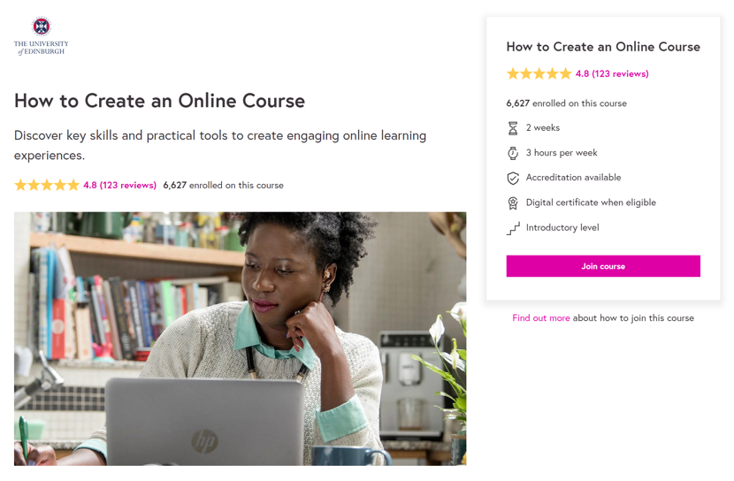
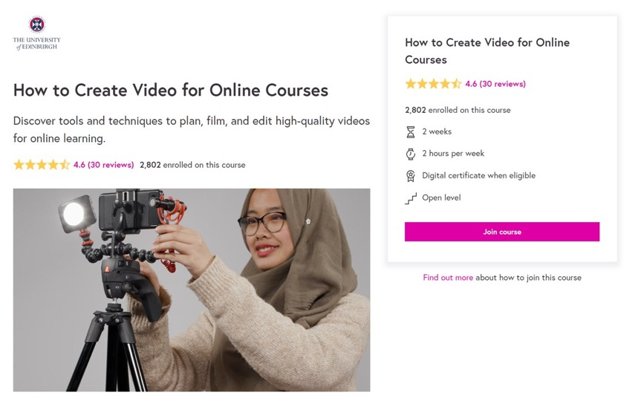
'How to Create' Courses
Notes:
In addition to the other resources we have openly available, we have created 2 moocs on how to create online courses and how to create video for online courses, these are available on Coursera and Futurelearn and share our knowledge and experience of creating online courses and making the most of the resources you have.

Slide 11
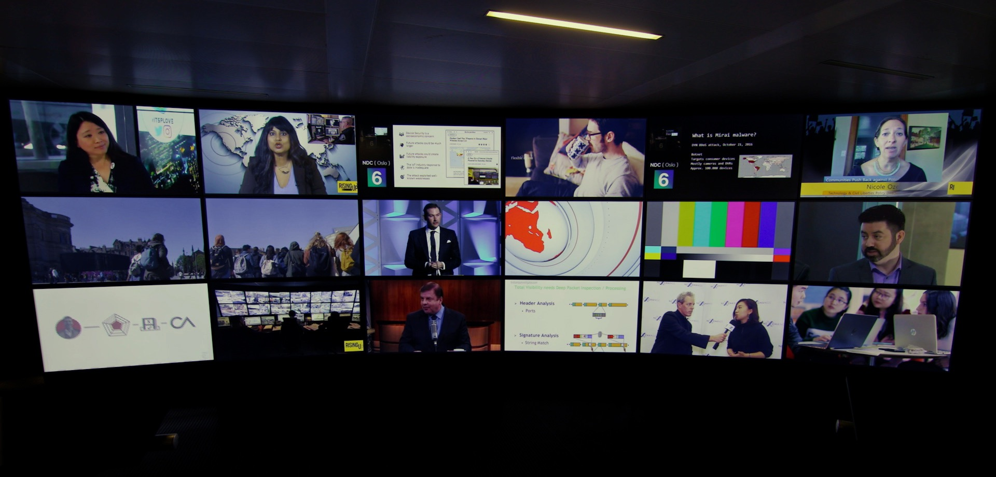
Developing Open Media
Notes:
Creating Open media has it’s challenges, but it isn’t as difficult as you might think.
Sometimes people can be skeptical about releasing their videos under a Creative Commons license.

Slide 12
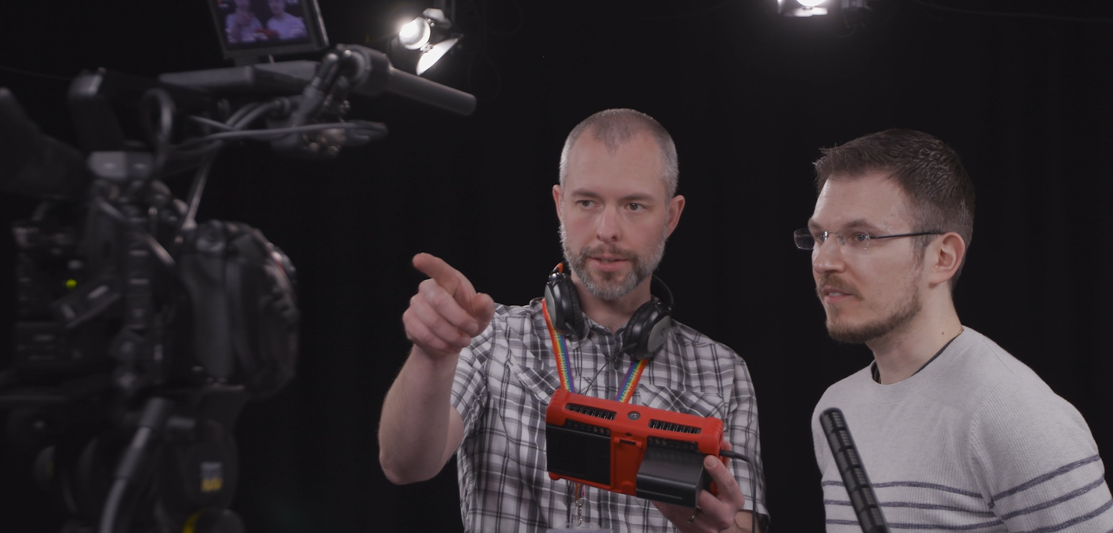
Engaging with participants
Notes:
But everyone we’ve worked with has got on board, once we’ve explained the benefits of being able to re-use the media in any of their teaching, and that it’s not giving away copyright, but enabling others to use the resource (or elements of it) in their own teaching. And also that anyone reusing it has to attribute the work and share it under the same Creative Commons license.

Slide 13
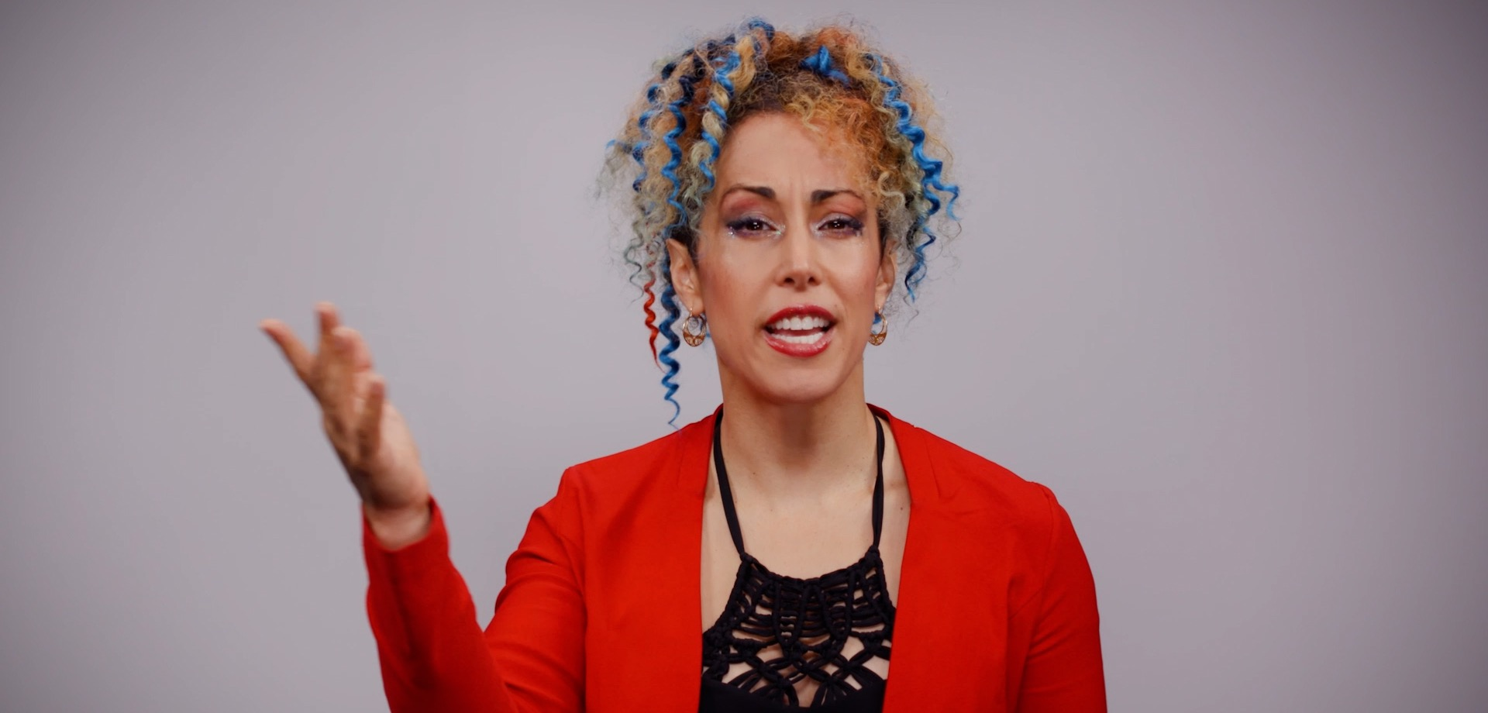
Additional footage
Motion graphics
Images
Notes:
Most of the videos we produce are Piece to camera or talking heads and these nearly always benefit from additional footage, graphics or images to illustrate certain points or to make it more interesting and engaging. Add

Slide 14
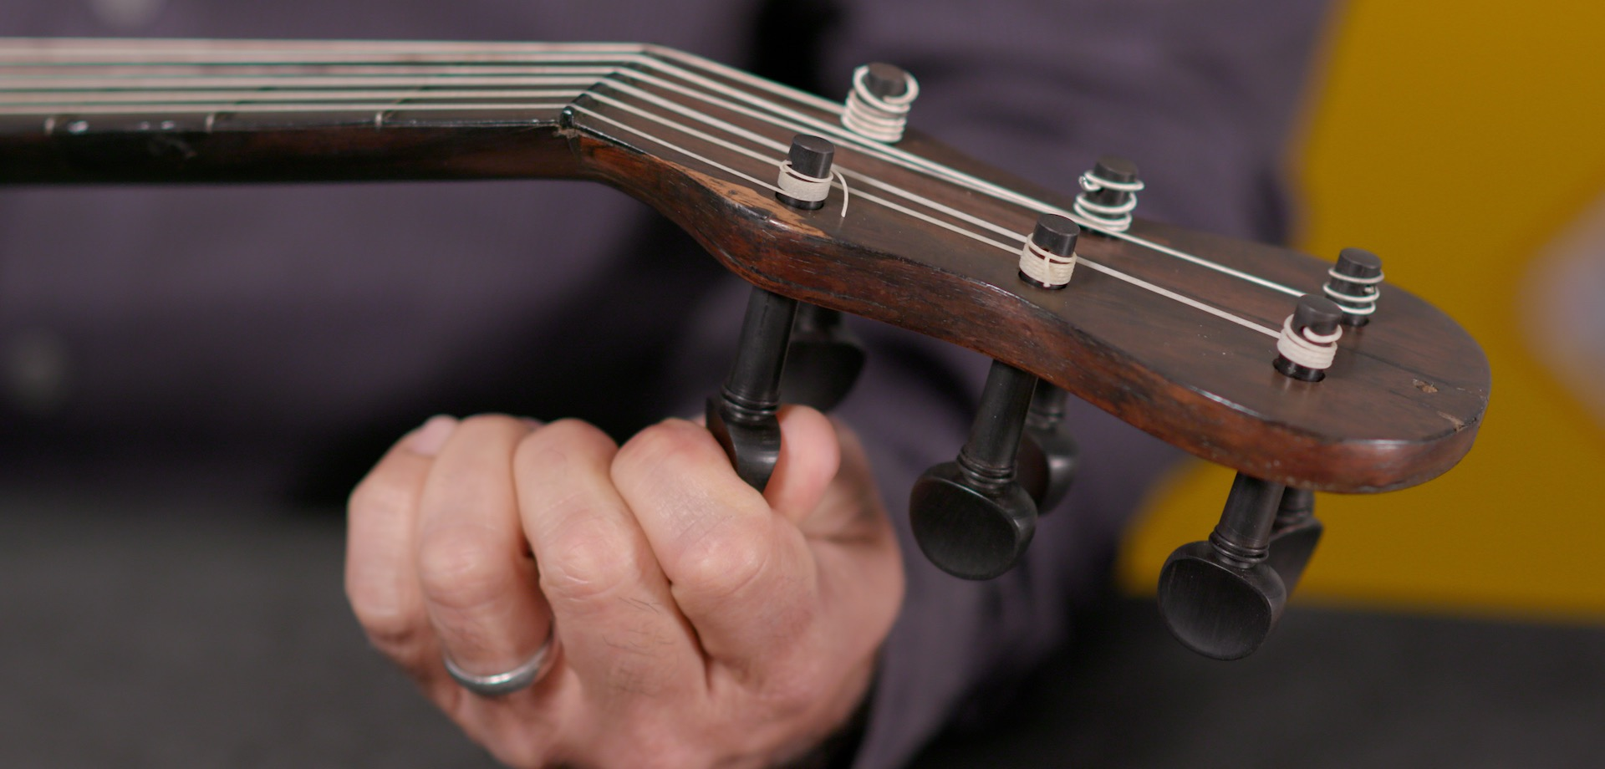
Additional footage
Shoot it yourself
Notes:
Sometimes the extra footage is very specific and we can easily get the required shots ourselves, often during the same recording session. This makes open licensing easy because we’re the owners of the material.

Slide 15
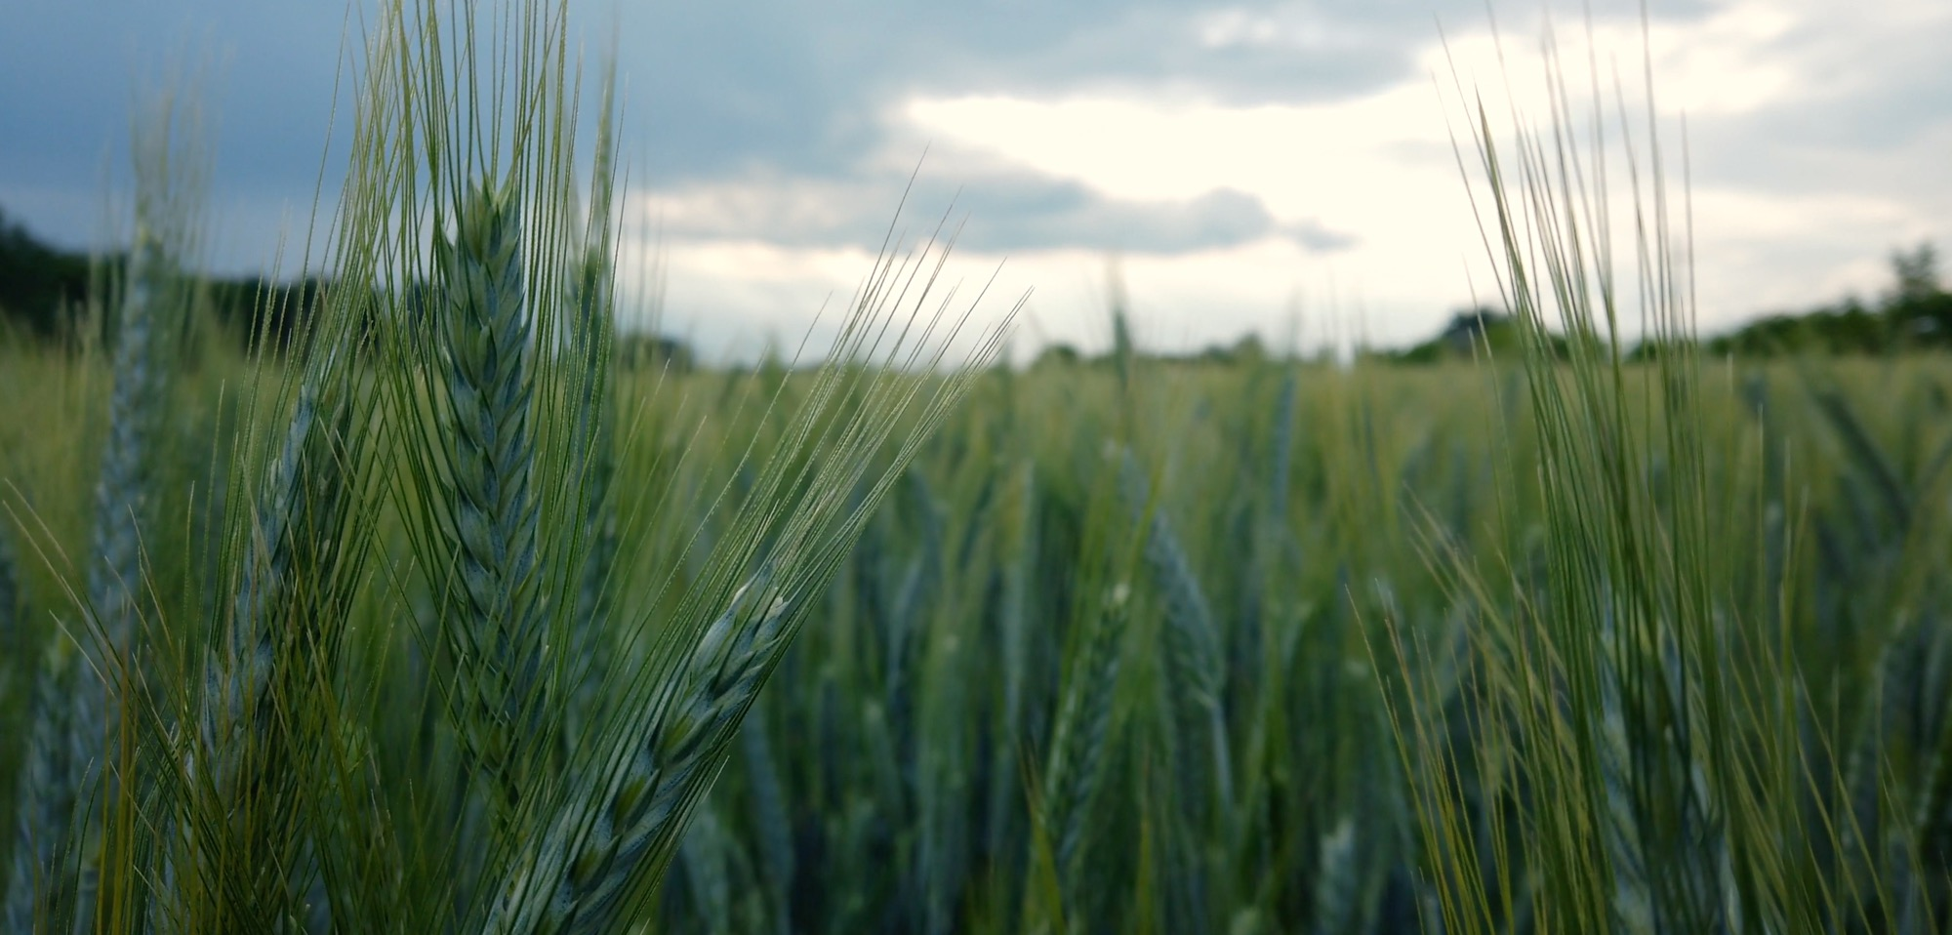
Additional footage
Free to use or Creative Commons stock footage
Pexels and Pixabay
Attribution
Wheat field, free to use, ha11ok, Pixabay https://pixabay.com/videos/green-wheat-field-agriculture-40724/
Notes:
Often the shots we need are more generic or could take a lot of time and effort to capture. This is where finding openly licensed stock footage comes in. We have to make sure that anything we use is either completely free to use or has been released under an appropriate Creative Commons license. This can be a challenge when you’re new to it because you’ll come across terms like “royalty free” or “copyright free”, which sound like they should be ok, but generally aren’t. Most stock footage, whether it’s free or paid for will have a restrictive license attached to it, meaning you wouldn’t be able to release your video under creative commons. A couple of good examples of open stock footage websites are Pexels and Pixabay because everything on those sites are completely free to use. There are plenty of other sites, but often there is mix of license types so you have to be careful which videos you use. We always give an attribution to any stock footage we use whether it’s a requirement of the license or not. Embedding this information in the video credits makes it clear we’ve used it appropriately and means other people can find the original footage if they want to use it or check the licence.

Slide 16
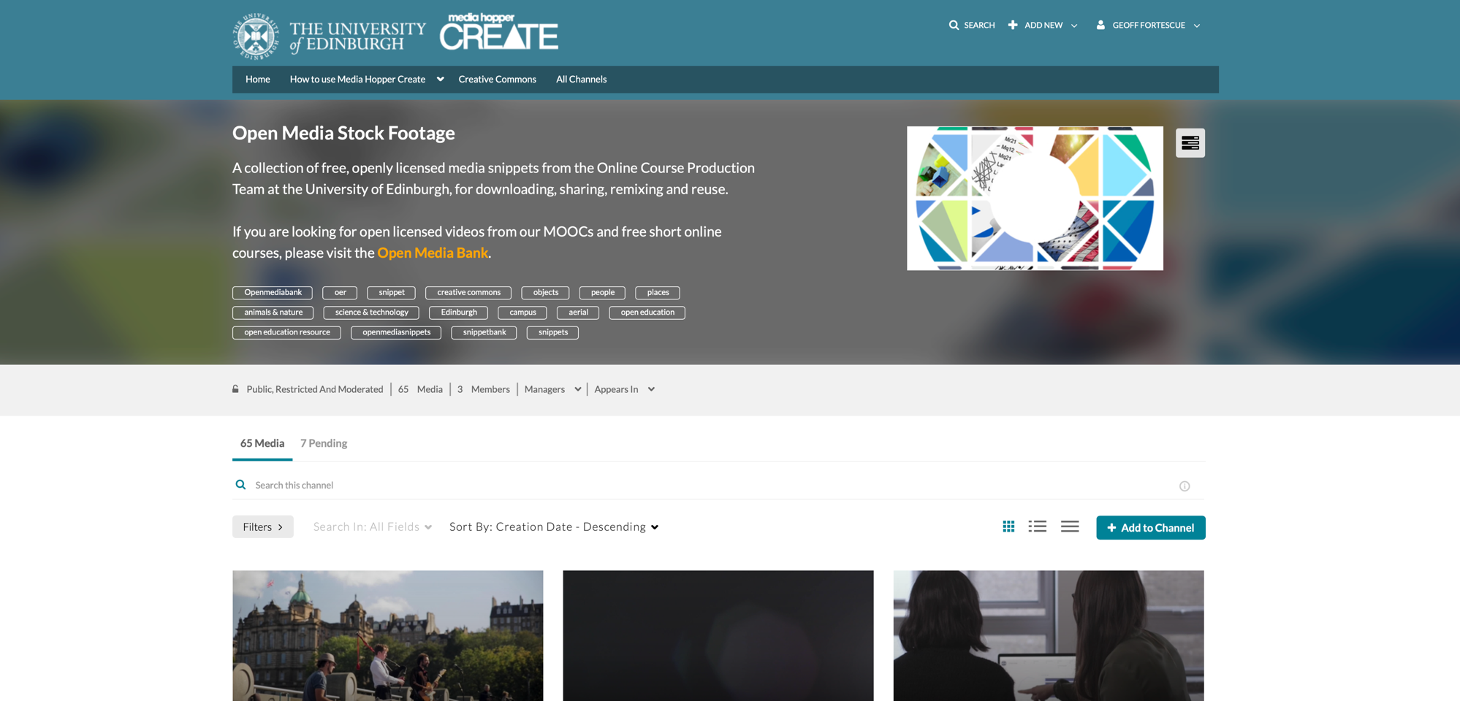
Notes:
Whenever we shoot anything that could be useful as stock footage, we add clips to our Open Media Stock footage channel on Media Hopper as well as our Pexels account to reach a wider audience.

Slide 17

Motion graphics
Images
Notes:
The same rules apply to motion graphics and images. Something we’ve come up against a few of times is when someone has commissioned motion graphics or animations from an external supplier for a previous project and then wanted to use them in a MOOC, only to find they don’t have permission to use those assets for any other projects, let alone release them under a Creative Commons license. This isn’t uncommon when getting graphics, photographs or videos produced by commercial companies. Their standard terms will normally only allow use for a specific project and you would need to be clear from the outset that you wish to release under creative commons or you’re likely to run into problems later.

Slide 18
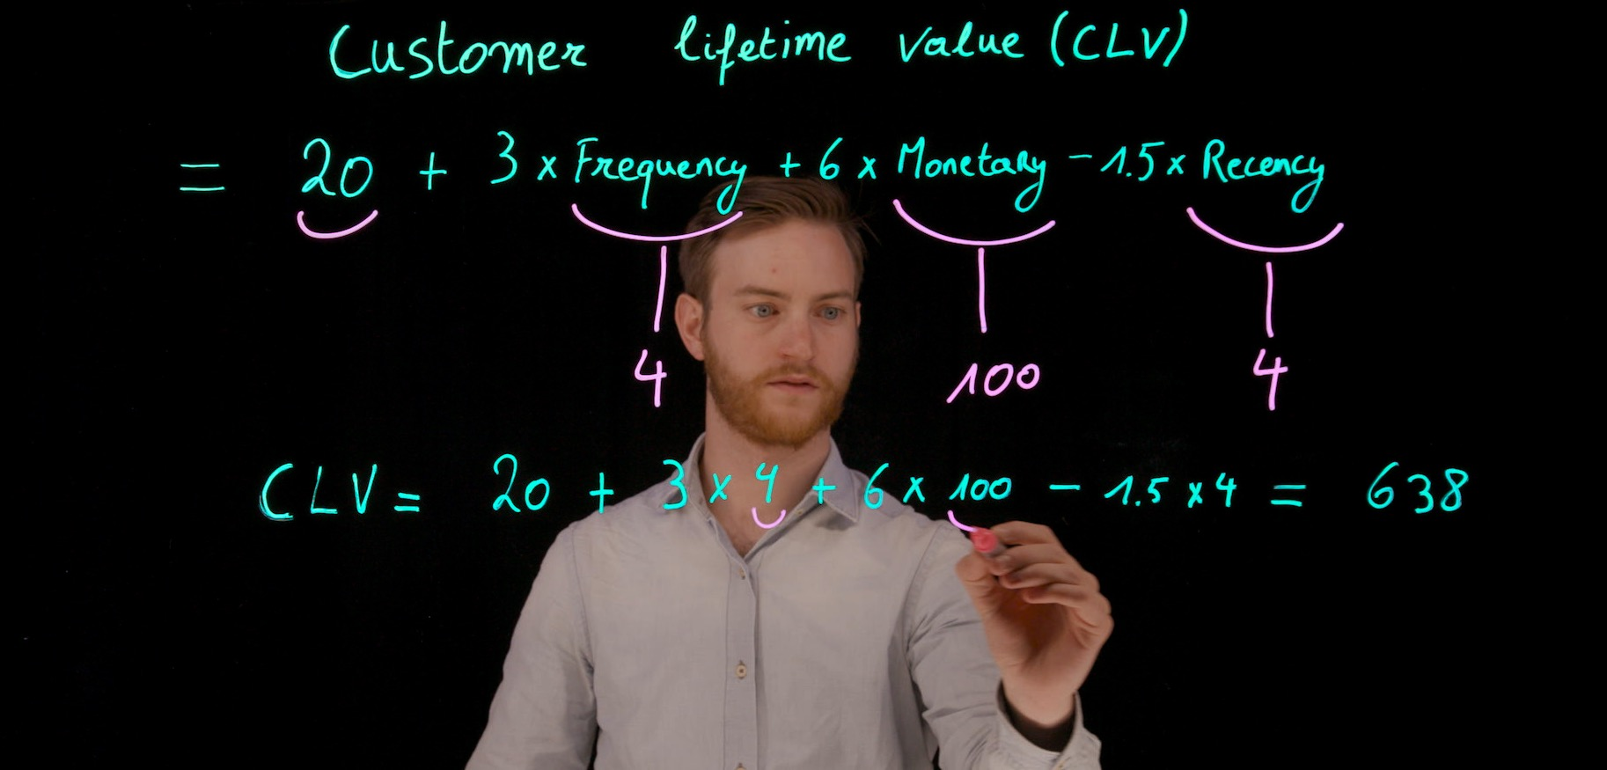
Notes:
We’re often asked to incorporate slides from teaching presentations into videos, and while there are often more creative ways of illustrating a point which we would prefer anyway, the most common issue is that a graph, chart or image has been used that wasn’t created by the academic. This is generally ok for teaching materials in a classroom and would be refenced appropriately, but it can’t be used in video that will be publicly available and released under an open license. So an alternative solution has to be found and that will be different in every situation.

Slide 19
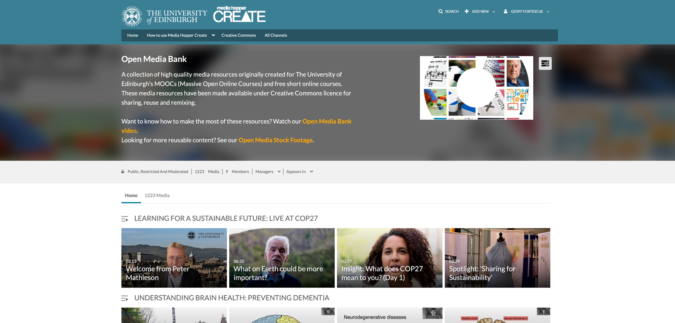
Notes:
Finally, once we’ve created our media that we can release under Creative Commons, as well as being published in the course it was made for, it’s added to the Open Media Bank channel on Media Hopper. Here you can find over 1200 videos, organized into course playlists, from Breeding programme modeling with Alpha simR to Philosophy to chicken behavior and welfare. These can be shared, downloaded and used in course materials, incorporated into new videos or just watched to learn something new.

Slide 20
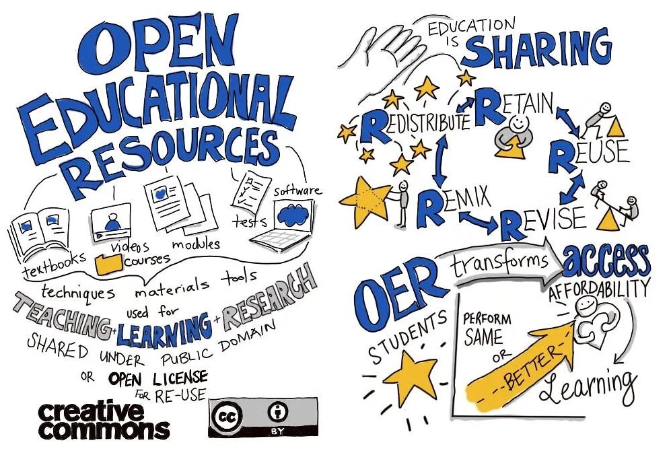
Creative re-use of open media
OER is Sharing, Guilia Forsyth, CC0.

Slide 21

Open eTexbooks for Access to Music Education project blog https://blogs.ed.ac.uk/opentextbooks/
Notes:
Open education can encompass many different things. These are just some of the aspects of open education

Slide 22
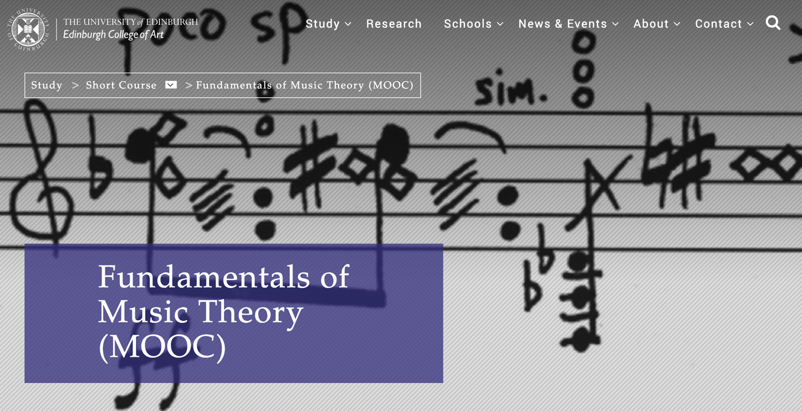
Fundamentals of Music Theory https://www.eca.ed.ac.uk/study/short-course/fundamentals-music-theory-mooc

Slide 23

Open Textbooks, Guilia Forsyth,
Public Domain Image on Flickr,
https://flic.kr/p/eR9rSr
Notes:
Open education can encompass many different things. These are just some of the aspects of open education

Slide 24
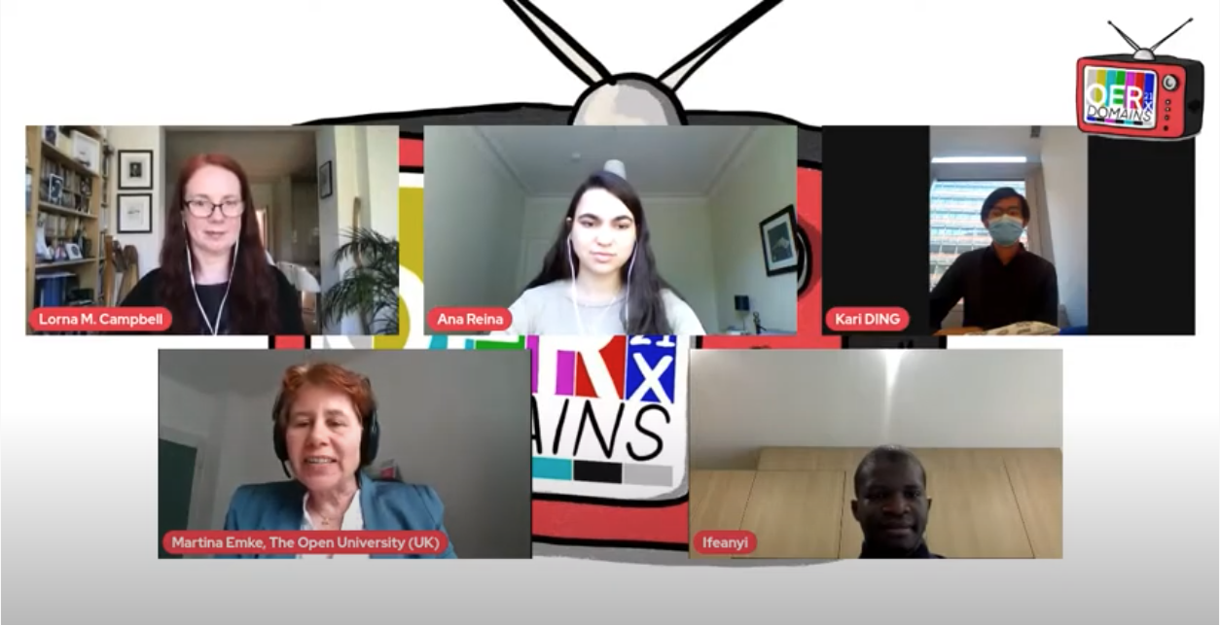
Our student partners: Ana Reina Garcia, Kari Ding, Ifeanyichukwu Ezinmadu.
Notes:
Open education can encompass many different things. These are just some of the aspects of open education

Slide 25
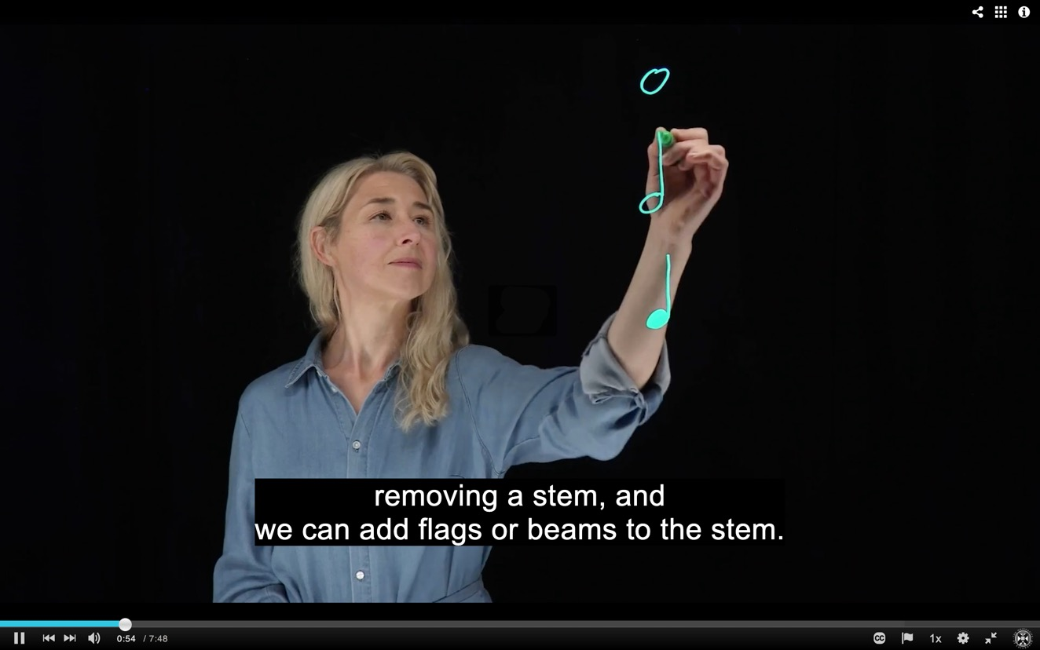
Dr Nikki Moran, Senior Lecturer, Reid School of Music.
Notes:
Open education can encompass many different things. These are just some of the aspects of open education

Slide 26

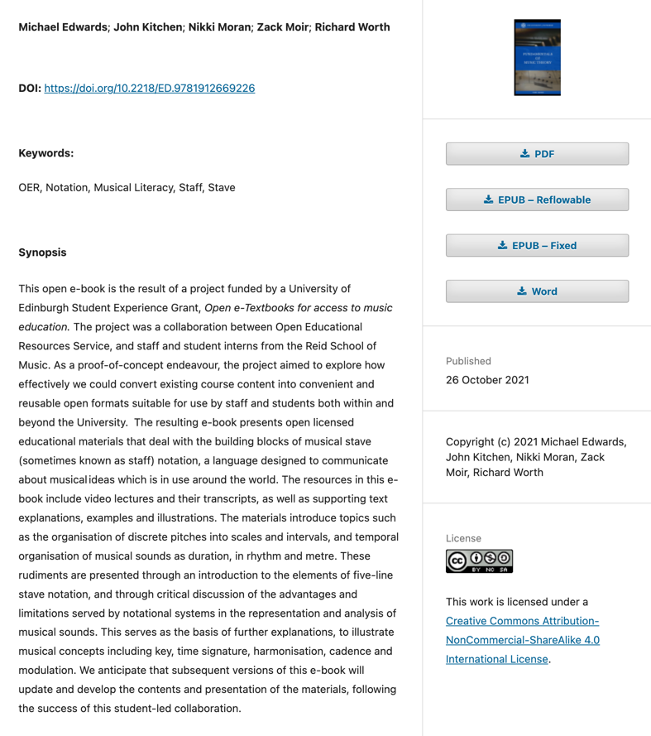
Notes:
Open education can encompass many different things. These are just some of the aspects of open education

Slide 27

https://books.ed.ac.uk/edinburgh-diamond

Slide 28


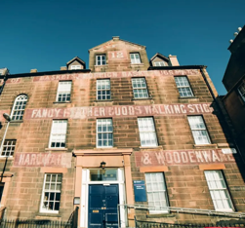
Coursera MOOC (2014)
One semester 20 credit BMus Music course (2018)
Open etextbook (2021)
Fundamentals of Music Theory
Revised Coursera MOOC (2022)
Free to use image by Tima Miroshnichenko on Pexels

Slide 29
“OER means opportunity to me. The opportunity to share knowledge of a subject in a more accessible format that is mostly not bound by financial capability to access the material. Hereby, creating a channel that facilitates equal educational opportunity for all.
Through this project, I have developed a better understanding that OER present flexibility for students, teachers, content creators and end users to have access to, modify, and adapt materials in a way that is not usually permissible via traditional textbooks”
~ Ifeanyichukwu Ezinmadu

Slide 30
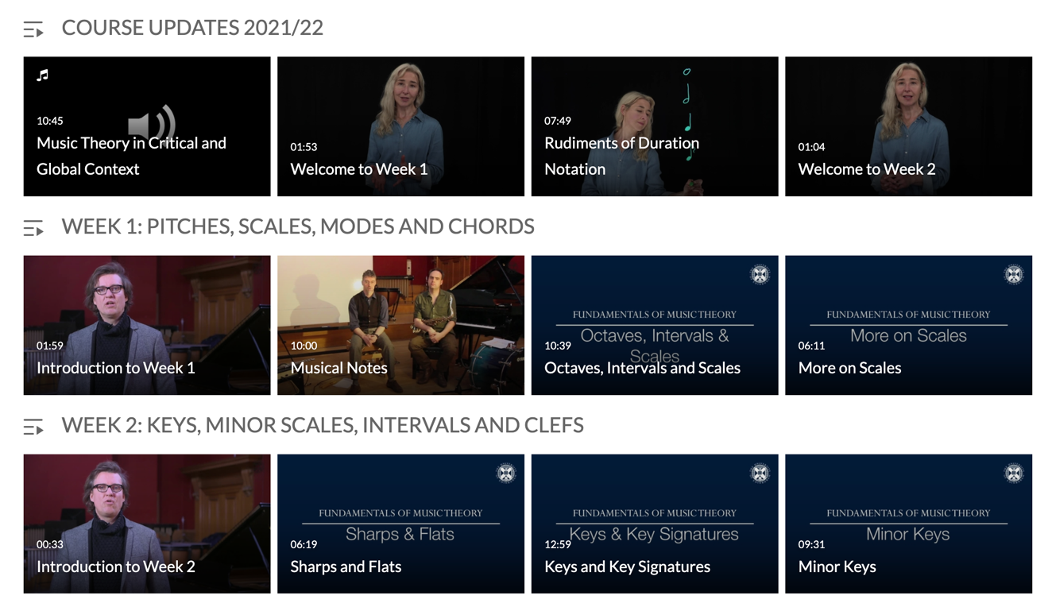
Fundamentals of Music Theory Channel https://media.ed.ac.uk/channel/Fundamentals+of+Music+Theory/
Notes:
Open education can encompass many different things. These are just some of the aspects of open education

Slide 31
Fundamentals of Music Theory
Open eTextbook https://books.ed.ac.uk/edinburgh-diamond/catalog/book/ed-9781912669226
Coursersa MOOC https://www.coursera.org/learn/edinburgh-music-theory
Open licensed videos https://media.ed.ac.uk/channel/Fundamentals+of+Music+Theory/
Project blog https://blogs.ed.ac.uk/opentextbooks/
Notes:
Open education can encompass many different things. These are just some of the aspects of open education

Slide 32
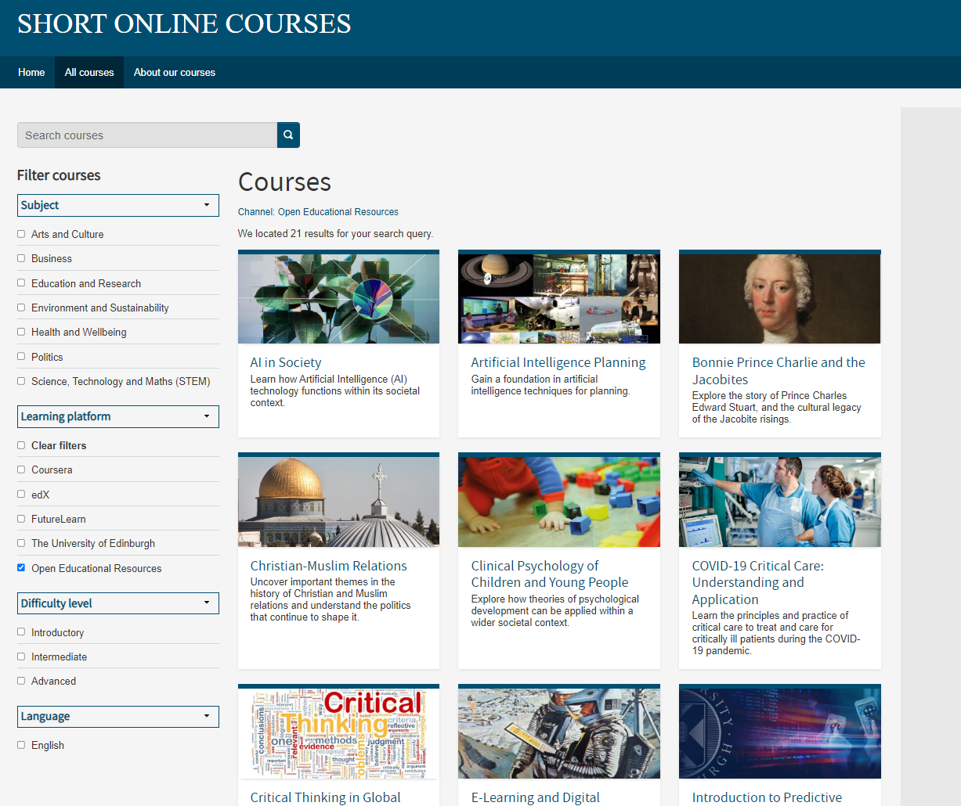
Promoting open learning opportunities
Open educational resources are given as much prominence on our website as courses.
www.onlinecourses.ed.ac.uk
Notes:
I’m going to talk briefly about how we promote our open educational resources and also how openness is embedded in our image choices too when it comes to marketing our courses.
Open educational resources are treated equally to our courses. We have a filter on our website so that visitors can filter just to OERs if they wish. On this screenshot you can see some of the OERs we have on offer. Some were made from scratch for that purpose e.g. AI in society but most are courses that have been archived but the resources are still openly available for learners to access.

Slide 33
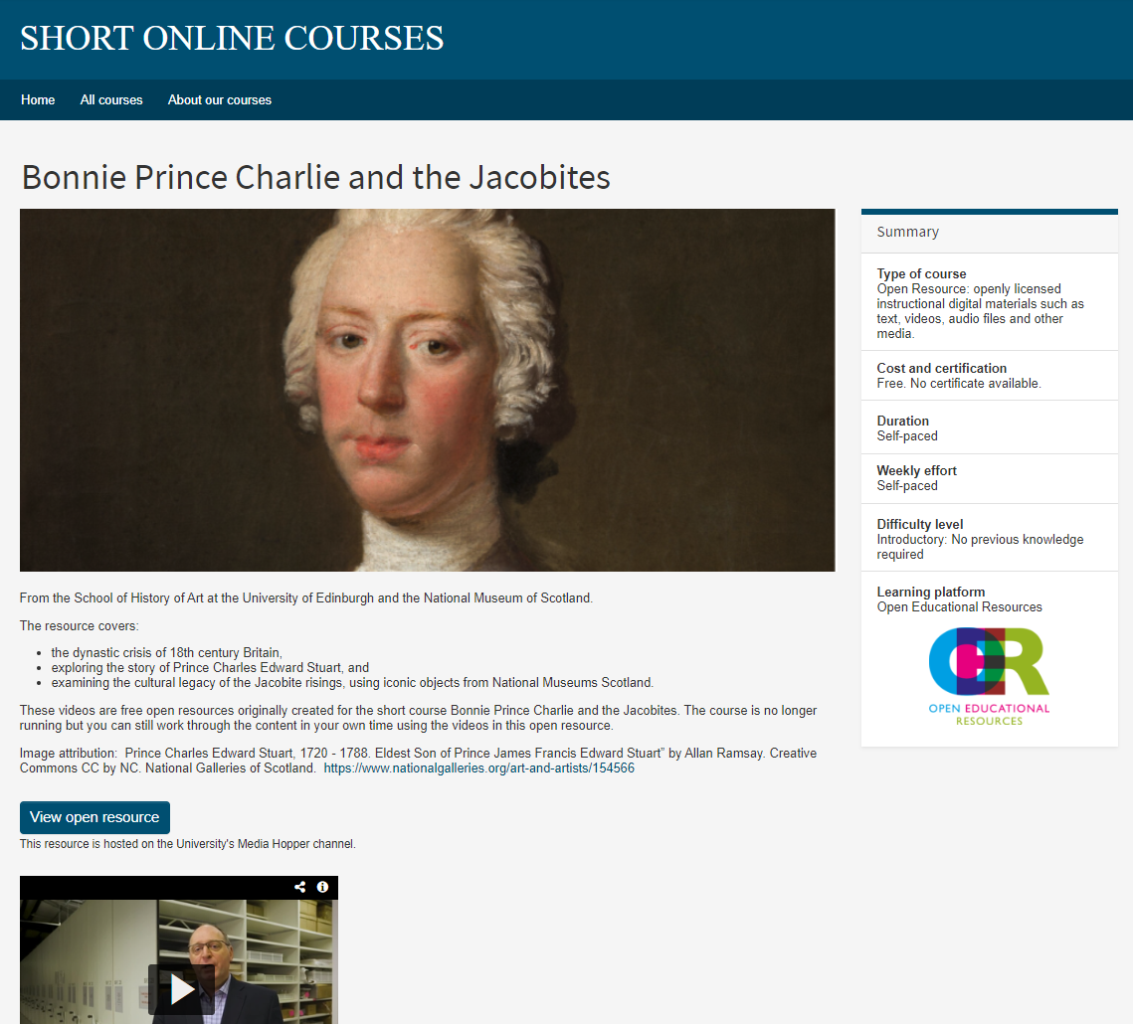
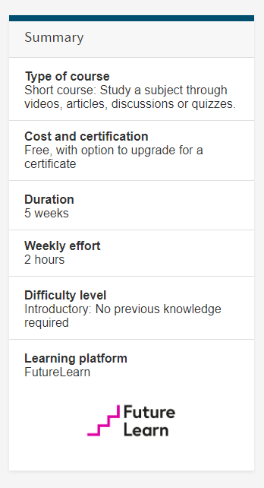
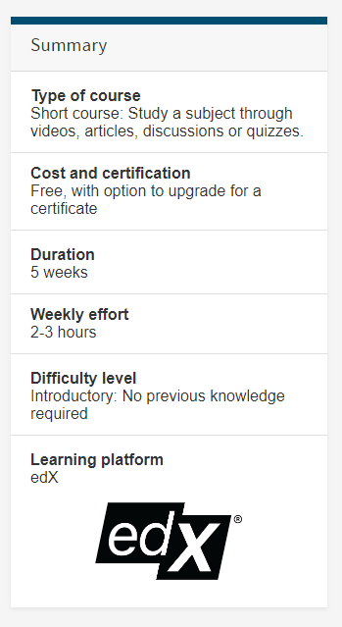
Notes:
This is an example listing from our website for an OER – follows same layout as a “course” – brief summary etc. For courses we use the platform logo to indicate the learning platform e.g. edX logo, FL logo on right, but for OERs we have chosen to use this logo to help visually indicate that it’s an OER – we think this also helps give the OERs a little more credibility as a learning material by treating them almost as a brand in their own right, like the global learning platforms.
We currently don’t have image attributions on our website as almost all images we use don’t require attribution because they are free to use or public domain images - but as you can see for this particular Bonnie Prince Charlie image it’s CC by NC and it has some attribution terms we have to meet.

Slide 34
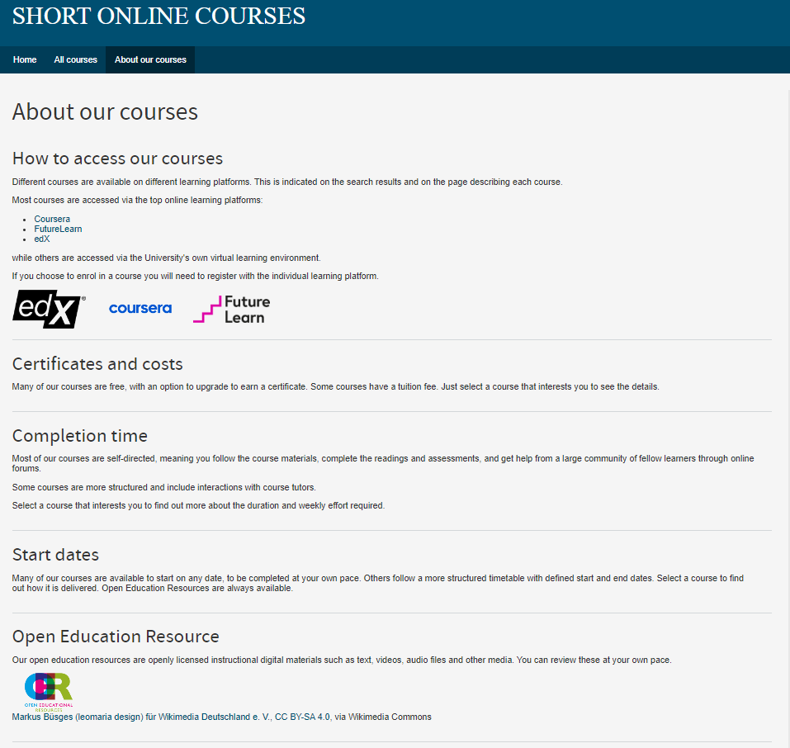
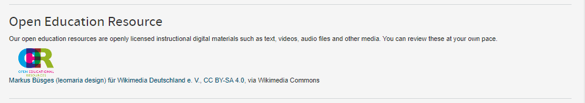
Notes:
We also give credit to the OER logo designer and a link on our “about us” page.

Slide 35
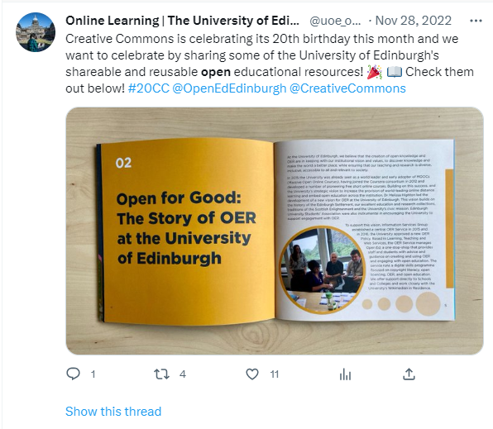
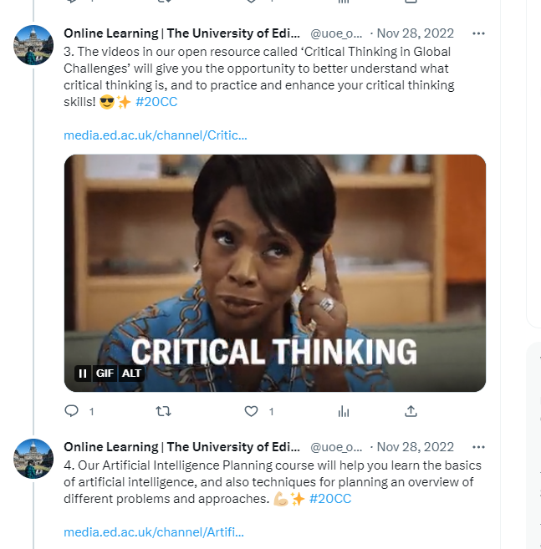
Notes:
We actively promote our OERs on social media, as we do with courses. We jump on hooks like international day of X or as you can see here we celebrated 20 years of Creative Commons.

Slide 36

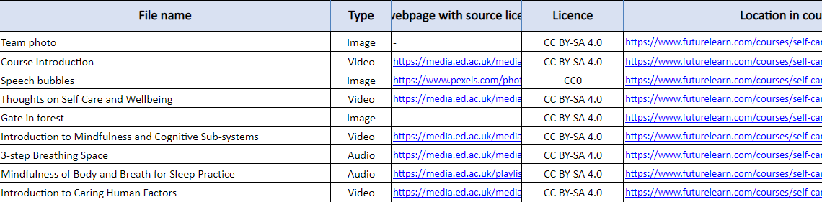
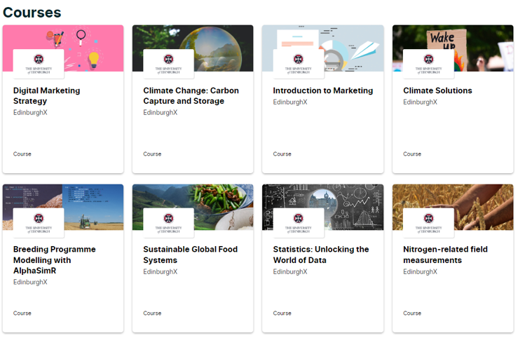

The spirit of ‘open’ is applied also to marketing assets; we use openly licensed imagery and video footage for course landing pages, marketing graphics, and course trailers.
Notes:
The spirit of ‘open’ is applied also to marketing assets; we use openly licensed imagery and video footage for course landing pages, marketing graphics, and course trailers.
This does mean we have to be careful in our choice of imagery - so we work closely with the academic team to make sure the image safely reflects the course or resource. Does it say the right thing about the course, does it represent it correctly? When choosing the bookshop image for example we had shortlisted one which was of a famous New York bookshop – while not a problem per se, it was better once the academic flagged this and we were able to find this photo of a bookshop in Edinburgh – much more fitting for a course that is conducted in partnership with the Edinburgh International Book festival! There’s always the risk with open images that another course uses same image but learning platforms help check that for us.
This approach of using openly license images is unique to marketing our moocs and oers – for degree programme marketing we actually tend to commission our own photography so that they are unique to the University and to avoid risk of also being used by other unis. We did have one instance where an open image we’d used on our online masters degrees website was also spotted on Tesco’s website but haven’t spotted any since then! There are a lot of open images out there though thankfully!

Slide 37
Looking to the future
Ongoing institutional commitment to open education.
Finding new ways to use content we’ve already created.
MOOCs continue to be useful, but partners change business model / approach and we need to manage risk.
Being 'open' helps manage risk (not reliant on any one partner).
Dual listing / internal reuse.
Platform strategy (new short courses platform).
New forms of credentialing (new badges platform).
Still experimenting in the space between open and for-credit education.

Slide 38
QUESTIONS?

Slide 39
Further information
Online Course Production Service
Web: https://www.ed.ac.uk/information-services/learning-technology/onlinecourse-production
Email: course-production-team@ed.ac.uk
OER Service
Web: https://open.ed.ac.uk/
Email: open.ed@ed.ac.uk
Short Online Courses
Web: https://www.onlinecourses.ed.ac.uk/
Open Media Bank
Web: https://media.ed.ac.uk/channel/Open%2BMedia%2BBank/
This presentation is licensed CC BY 4.0, University of Edinburgh, unless otherwise indicated.

Slide 40

Further information
Online Course Production Service
Web: https://www.ed.ac.uk/information-services/learning-technology/onlinecourse-production
OER Service
Web: https://open.ed.ac.uk/
Short Online Courses
Web: https://www.onlinecourses.ed.ac.uk/
Open Media Bank
Web: https://media.ed.ac.uk/channel/Open%2BMedia%2BBank/
This presentation is licensed CC BY 4.0, University of Edinburgh, unless otherwise indicated. ​

